Slide 1
BREAKING INTO FILM ANALYSIS
NAME: GROUP 5
1. Mika Benson
2. Filda Kiarie
3. Grace Mwende
4. Austin Kanja
5. Chris Kimau
6. Nicholas Miencha
7. Franciscar Mutie DATE: NOVEMBER - 2024

Slide 2

INTRODUCTION OVERVIEW
STARTING A NEW MOVIE STUDIO
Our company is embarking on an exciting venture, entering the burgeoning film industry with the launch of a new studio. This initiative comes at a time of unprecedented growth in the demand for original video content, prompting us to explore the intricacies of film production. As part of our strategy, we aim to become a formidable player in the film market by harnessing market insights and trends.

Slide 3

PROBLEM STATEMENT
NAVIGATING THE FILM MARKET
In response to the growing trend of corporations producing their own video content, our company is entering the film market. However, the lack of experience in movie production presents a significant challenge. We must analyze how different types of films perform at the box office to ensure our new studio's success. Through careful research, we aim to gather insights that can guide the type of films we should create, ensuring alignment with market demand.

Slide 4
OBJECTIVES
1. GENRE PERFORMANCE EVALUATION
3. REVENUE AND BUDGET ANALYSIS
2. IDENTIFY SUCCESSFUL STUDIOS
Evaluate the performance of various film genres in both domestic and international markets.
Identify the movie studios that consistently produce high-performing films.
Investigate the correlation between production budgets and both domestic and international revenues.

Slide 5

OBJECTIVES…
4. PRODUCTION TRENDS OVER TIME
Film production trends provide insights into industry changes. While popularity may indicate initial interest, a film's lasting impact depends on its artistic quality. Understanding these trends helps studios strike a balance between creativity and market demands.
5. POPULARITY SCORE INSIGHTS & AVERAGE RATING SIGNIFICANCE
A film's popularity score reflects its cultural and commercial resonance with audiences.
Average rating represents collective opinions from critics and audiences, serving as an indicator of a film's perceived quality and storytelling prowess

Slide 6
METHODOLOGY
EXPLORATORY DATA ANALYSIS
STATISTICAL ANALYSIS
MODEL EVALUATION AND PERFORMANCE METRICS
Exploratory Data Analysis (EDA) is a crucial initial step in data analysis. It summarizes dataset features, often through visuals, helping to understand trends, identify patterns, and detect anomalies in data. EDA outcomes direct modeling decisions to accurately represent relationships in film data, key for building effective predictive models.
Statistical Analysis uses methodologies to examine relationships between variables, validating assumptions and drawing inferences about populations based on samples. Techniques like hypothesis testing, regression, and variance analysis are common. This step reduces bias and errors, ensuring reliable outcomes. Statistical analysis substantiates key findings with quantitative evidence, enhancing credibility of conclusions.
Model evaluation uses metrics to assess the accuracy and effectiveness of predictive models. Metrics like accuracy, precision, recall, and F1-score indicate model performance. Evaluating models ensures they fit training data and generalize well to unseen data, which is essential for success. A systematic evaluation approach helps select the best model for deployment.

Slide 7
TOP PERFORMING GENRES
Overview of top genres performing at box offices.
GENRE | DOMESTIC PERFORMANCE | INTERNATIONAL PERFORMANCE
Action | High | Very High
Comedy | Moderate | Moderate
Horror | Low | High
Animation | High | High
Drama | Moderate | Low
Science Fiction | Very High | High

Slide 8

LEADING FILM STUDIOS
STUDIOS LEADING THE PACK
Several film studios have consistently produced movies that perform exceptionally well at the box office. These studios employ innovative strategies, such as leveraging global trends, investing in high-quality production, and engaging renowned directors and actors. By studying their approaches, our new studio can adopt best practices that align with successful film development.

Slide 9
BUDGET VS REVENUE
45%
25%
30%
PREMIUM PRODUCTIONS AND PROFITS
INDIE SUCCESS STORIES
STRIKING A BALANCE
45% of revenue is from high budget films.
25% of revenue is from low budget films.
30% of revenue is from mid-range budget films.

Slide 10
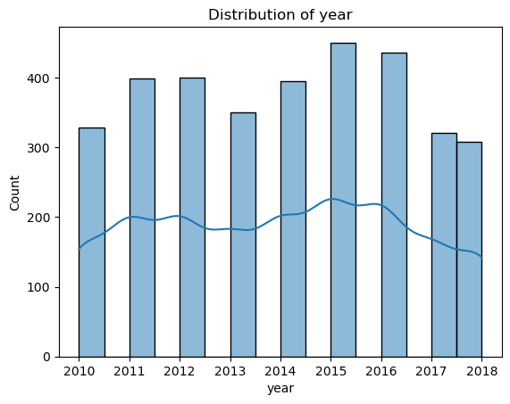
PRODUCTION TRENDS
EVOLVING FILM TECHNIQUES
Film production technology has seen major improvements in digital cinematography and visual effects. These advancements help lower production costs while enabling complex storytelling through enhanced visuals.

Slide 11
AUDIENCE IMPACT
Positive reviews from critics can boost a film's performance, functioning as a key influence on audience decision-making.
Films with higher popularity scores often see increased box office revenue, proving the importance of pre-release marketing.

Slide 12
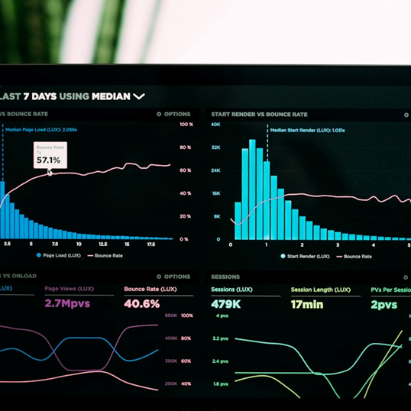
MODEL EVALUATION
PROJECTED REVENUE OVER NINE YEARS
The second model focuses on predicting expected revenue over the next nine years. This model utilizes data-driven forecasting to anticipate market trends and audience preferences, enabling strategic planning for future content.\n\nKey caveats include the volatility of entertainment markets and unpredictable shifts in consumer behavior, necessitating continuous model adjustments. Accuracy in short-term forecasts tends to be higher, with longer projections requiring more nuanced analysis.
IMPACT OF PRODUCTION BUDGET ON WORLDWIDE GROSS
The first model evaluated how varying production budgets influence the worldwide gross of films. By examining historical data, this model helps identify budget ranges that maximize revenue outcomes, providing valuable insights for studios when allocating resources.\n\nInitial findings suggest that while larger budgets can lead to higher revenues, they do not guarantee success. Results also highlight instances where modest budgets have outperformed expectations, emphasizing creative execution as a pivotal factor.

Slide 13



STRATEGIC INSIGHTS
GUIDELINES FOR SUCCESS
Based on our comprehensive analysis, our studio should focus on producing high-quality films in genres showing international appeal, such as action and science-fiction. Investing in experienced directors and creative talent will be essential. Furthermore, scaling production budgets to optimize, but not overspend, while actively engaging audiences via social media and strategic marketing campaigns, will be pivotal in aligning with market preferences.

Slide 14

CONCLUSION
SUMMARIZING KEY INSIGHTS
This analysis identified prevalent trends and key contributors to box office success. Strategic insights into genre performance, studio attributes, and budget allocations are crucial for guiding our film production decisions moving forward.

Slide 15
RECOMMENDATIONS
FOCUS ON ACTION AND FAMILY
PARTNER WITH SUCCESSFUL STUDIOS
OPTIMIZE BUDGET ALLOCATION
Given strong performance domestically, prioritize producing action and family films. These genres' universal appeal supports consistent box office success.
Collaborating with established studios can leverage their expertise. Such partnerships enhance our knowledge and capabilities in film production.
Incorporate a balanced approach to budget investment. Ensure funds are allocated thoughtfully across pre-production, production, and marketing.

